Slide 1
Research Privacy Overview
Manjit Gill
Senior Privacy Officer
University Privacy Office

Slide 2
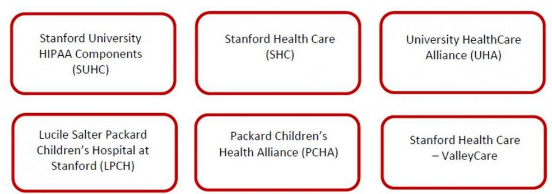
Stanford Affiliated Covered Entity (SACE)
HIPAA allows covered entities under common ownership or control to join to form a single covered entity.
Stanford University and Stanford Hospitals have formed the Stanford Affiliated Covered Entity that includes:
https://privacy.stanford.edu/other-resources/covered-entity

Slide 3
Stanford University HIPAA Components (SUHC)
SUHC conducting research related to a mental or physical condition, diagnosis, or treatment must comply with HIPAA and other applicable privacy laws.
May include the following research:
Analysis of existing data (chart reviews)
Analysis of existing specimens
Surveys/Interviews/Focus Groups
Observational Research
Interventional Studies

Slide 4
Health Information Portability and Accountability Act (HIPAA)
Federal law that applies to covered entities and individuals who handle Protected Health Information (PHI) within the covered entity.
Specifies how and when a covered entity may use and disclose PHI, including in the research context, and how to manage unauthorized uses and disclosures of PHI.

Slide 5
Protected Health Information (PHI)
Includes at least one of the 18 HIPAA identifiers in conjunction with health information:
Name | Photographic Images | Vehicle Identifying Numbers
Addresses | Social Security Numbers | Device Identifying Numbers
Dates | Medical Record Numbers | Web URLs
Phone Numbers | Health Plan Numbers | IP Addresses
Fax Numbers | Account Numbers | Biometric Identifiers
Email Addresses | Certificate/License Numbers | Any Other Unique Characteristic

Slide 6
HIPAA Privacy Rule
The Privacy Rule addresses:
The Minimum Necessary principle
Authorized uses and disclosures
Accounting of disclosures
Role-based access
Policies and procedures
Training
Third-party access and required agreements
Rights of individuals

Slide 7
Minimum Necessary Principle
HIPAA requires researchers (under the covered entity) to actively make a determination about what is the minimum amount of information needed for each use or disclosure of PHI.
Researchers must always consider whether the use or disclosure meets minimum necessary standards, including when:
Requesting access to PHI, including from patient records
Collecting and using PHI as part of the study
Disclosing PHI to sponsors, collaborators, and business associates

Slide 8
General Data Protection Regulation (GDPR)
Provides greater protection and data rights for individuals in the European Economic Area (EEA)
Personal data is defined as any information relating to an identified or identifiable natural person (‘data subject’)
An identifiable natural person is one who can be identified, directly or indirectly.
Additional requirements for special categories of personal data:
Racial or Ethnic Origin | Genetic Data
Political Opinions | Biometric Data
Religious or Philosophical Beliefs | Health Data
Trade Union Membership | Sex life and Sexual Orientation

Slide 9
General Data Protection Regulation (GDPR)
Additional Requirements:
Standard Contractual Clauses (SCC):
Standard sets of contractual terms and conditions which the sender and the receiver of personal data both agree to
Aimed at protecting personal data leaving EEA through contractual obligations with territories not considered to offer adequate protection to the rights and freedoms of data subjects.
Additional Consent Form Language
Provided by IRB

Slide 10
Agreements
Business Associate:
HIPAA allows Covered Entities to engage with external individuals or entities to conduct work that involves PHI on behalf of the Covered Entity.
Third parties are called Business Associates and are held to most of the same requirements under HIPAA as the covered entity.
Examples of business associates in the research context include cloud storage providers and customized app developers.
Research collaborators, sponsors, and sub-recipients are not considered Business Associates.

Slide 11
Agreements
Data Use Agreement (DUA):
Commonly used between research collaborators.
A contract or other written arrangement between the covered entity and the recipient of a Limited Data Set that must:
Describe the permitted and required uses of PHI by the recipient;
Provide that the recipient will not use or further disclose the PHI other than as permitted or required by the contract or as required by law; and,
Require the recipient to use appropriate safeguards to prevent the use or disclosure of the PHI other than as provided for by the contract

Slide 12
Limited Data Sets (LDS)
An LDS may contain:
City, State, Zip Code
Elements of Dates
Other Numbers, Characteristics, or Codes not listed as Direct Identifiers
Researchers may use or disclose LDS for research without a HIPAA Authorization provided that the disclosing entity and the recipient of the LDS enter into a DUA
The requirements of the HIPAA Privacy and Security Rules apply to Limited Data Sets

Slide 13
De-Identification
Covered Entities may use and disclose de-identified health information without restriction under the Privacy Rule, however contracts or other mechanisms to protect the de-identified data may still be needed.
Under HIPAA, there are only two methods for de-identifying health information:
Safe Harbor
Expert Determination

Slide 14
De-Identification
Safe Harbor:
Under this method, data is de-identified if ALL 18 HIPAA identifiers are removed
Name | Photographic Images | Vehicle Identifying Numbers
Addresses | Social Security Numbers | Device Identifying Numbers
Dates | Medical Record Numbers | Web URLs
Phone Numbers | Health Plan Numbers | IP Addresses
Fax Numbers | Account Numbers | Biometric Identifiers
Email Addresses | Certificate/License Numbers | Any Other Unique Characteristics

Slide 15
De-Identification
Expert Determination:
Requires a person with appropriate training, experience, and knowledge of statistical and scientific principles and methods specific to health information de-identification methodologies to apply such methods and principles to determine whether there is a very small risk that the information could be used by the recipient, alone or combined with any other information, to re-identify any data subject
Requires robust documentation of the methodologies used and analysis that leads to the final conclusion of “very small risk” of re-identification

Slide 16
HIPAA Authorizations
Research using only decedent PHI:
HIPAA protections extend to PHI of deceased individuals for 50 years following the date of death
PHI of decedents may be used for research without a HIPAA Authorization if the research provides the following:
Representations that the use and disclosure is sought solely for research on the PHI of decedents;
Representations that the PHI for which use or disclosure is sought is necessary for the research purposes; and,
Documentation, at the request of the Covered Entity, of the death of the individuals
Contact the Privacy Office to complete the decedent research representation document

Slide 17
Incident Reporting
An incident is any actual or suspected:
Unauthorized access, use, or disclosure of PHI,
Unauthorized access to systems that contain PHI, or
Violation of Stanford’s HIPAA policies and procedures
A breach of unsecured PHI and non-PHI personal data may require notification to research subjects, the government, and other third parties.
Any actual or potential incident, even inadvertent ones, should be immediately reported to the University Privacy Office for investigation.

Slide 18
Incident Reporting
Examples of incidents that must be reported immediately to the University Privacy Office include:
Failure to list research participants’ email addresses as BCC’s in an email message to multiple research participants
Failure to securely send email containing PHI (e.g., not putting “secure:” in the subject line)
Email containing an individual’s information sent to the wrong email address
Missing flash drive containing images or PHI
Lost or stolen devices, even encrypted ones
Lost, misplaced, or stolen study binders

Slide 19
Stanford Resources
Stanford provides several resources and tools to help faculty, staff, and students comply with research Privacy and HIPAA requirements:
Stanford Minimum Privacy Standards
Stanford Minimum Security Standards
HIPAA compliant platforms and tools

Slide 20
Thank You!
If you have any questions, you can contact the University Privacy Office by submitting a ServiceNow ticket: https://privacyrequest.stanford.edu/

